Slide 1

353- AI Project
Bayram Yavuz
122200058

Slide 2
Purpose
Solve an optimization problem
Compare simple vs metaheuristic algorithms
Measure cost and execution time

Slide 3
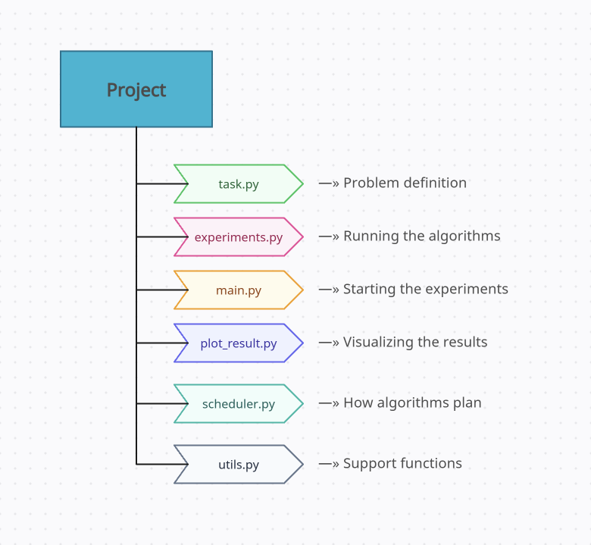
Requirements

Slide 4

Algorithms Used
Hill Climbing
Simulated Annealing
Genetic Algorithm

Slide 5
Genetic Algorithm
1) Random
2) Selection
3) Crossover
4) Best Path

Slide 6
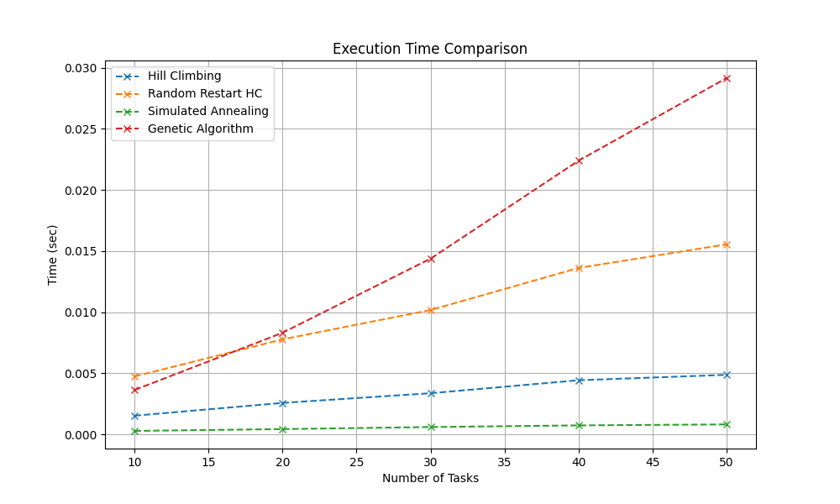
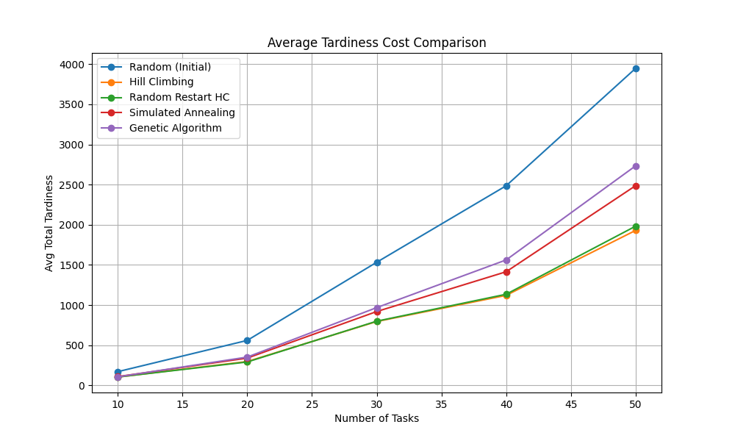
Experimental Results
These results show that the Genetic Algorithm is more efficient.

Slide 7

Conclusion
In this project, I compared different optimization algorithms.
The Genetic Algorithm produced the best results by efficiently improving random solutions.

